Slide 1
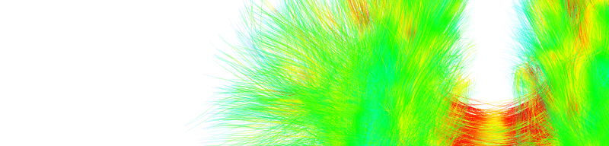
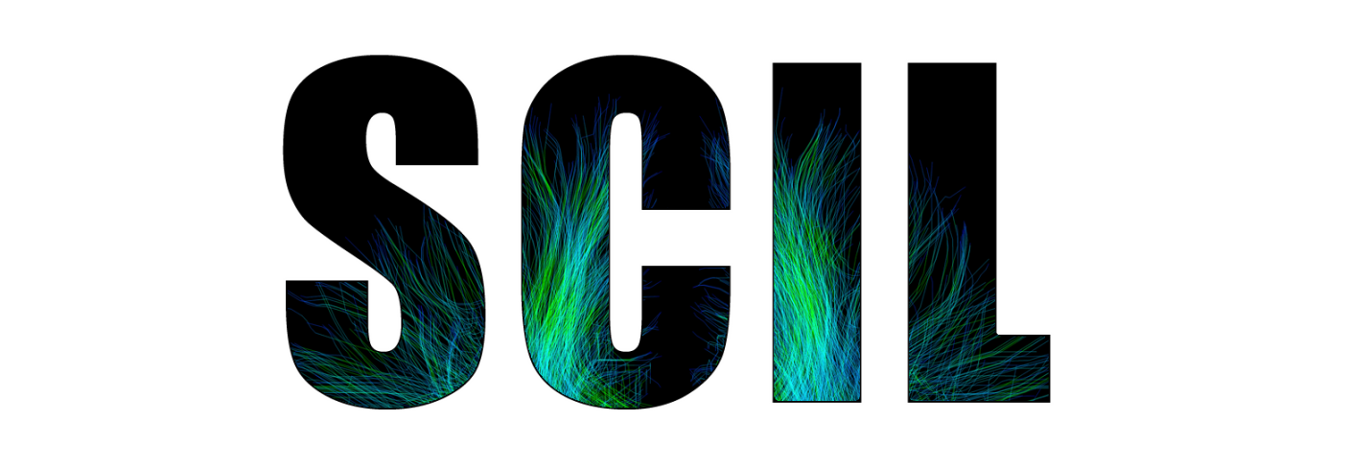


Diffusion
Tractography
Eleftherios Garyfallidis, Ph.D.
Diffusion Imaging in Python
http://dipy.org
Sherbrooke Connectivity Imaging
Laboratory (SCIL)
http://scil.dinf.usherbrooke.ca
Notes:
Merci Gilles Kahn

Slide 2
Basic principles

Slide 3
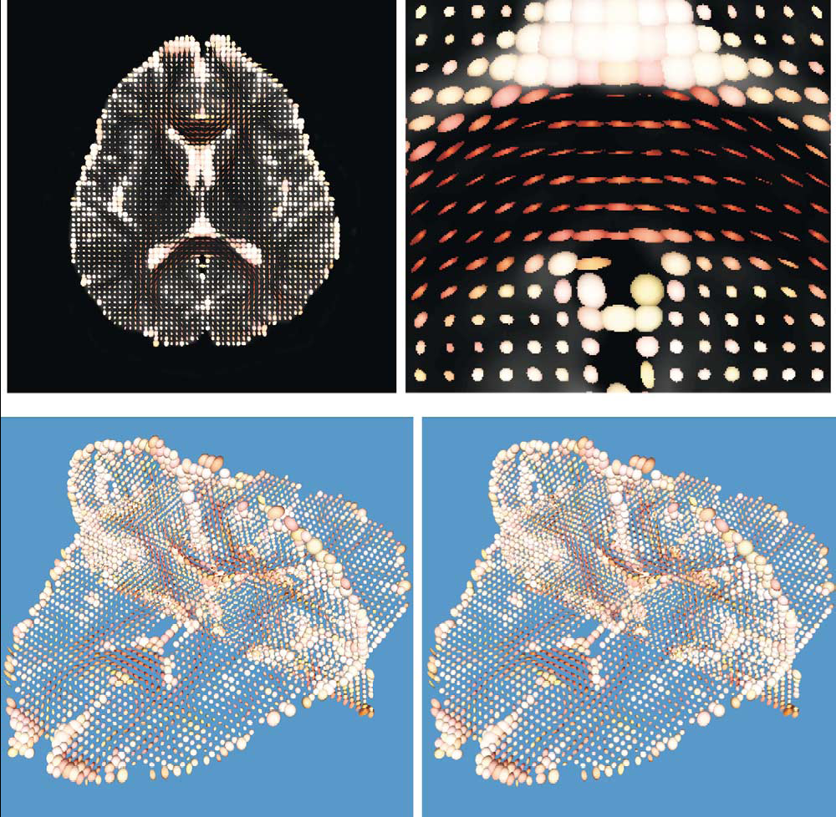
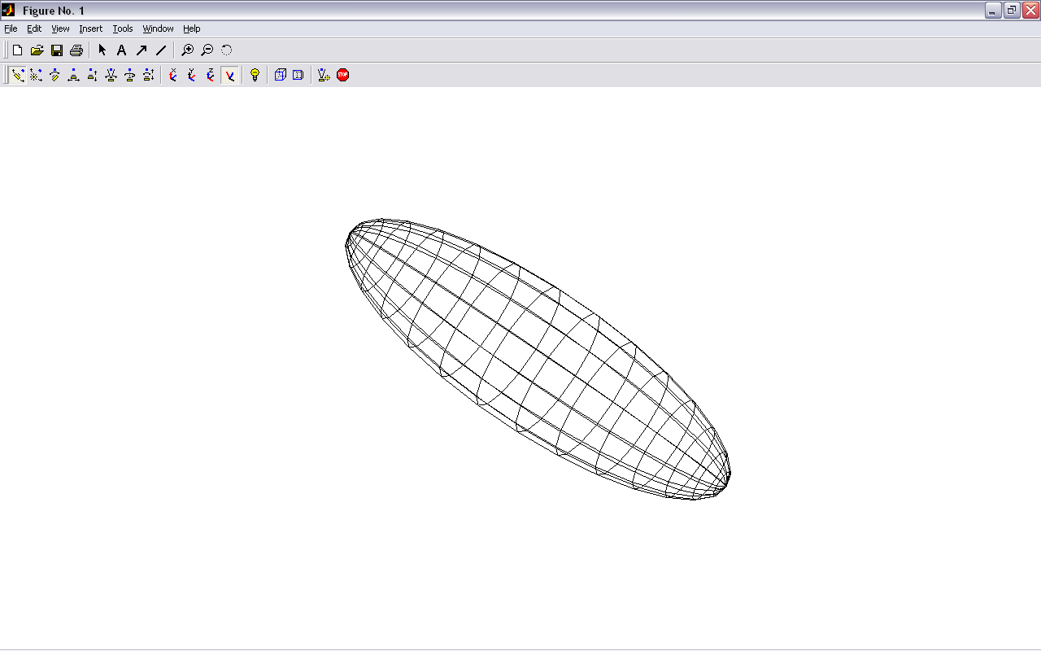
Main idea: Tensor-based tracking
z
v₁
λ₁
v₂
v₃
x
Y.Masutani et al.” European Journal of Radiology 46 (2003)

Slide 4
Connect the main directions voxel to voxel
z
v₁
λ₁
v₂
v₃
x

Slide 5
Deterministic tracking
If we assume the main eigenvector is tangential to the underlying trajectory of the white matter
Starting from a seed point we can propagate a 3D curve that represents the WM pathway
v₁
Two main approaches :
FACT - (Mori et al 1999)
Interpolated Streamlines (Euler, RK, etc) - (Basser et al. 2000)
Streamline Tractography
Seed Point

Slide 6
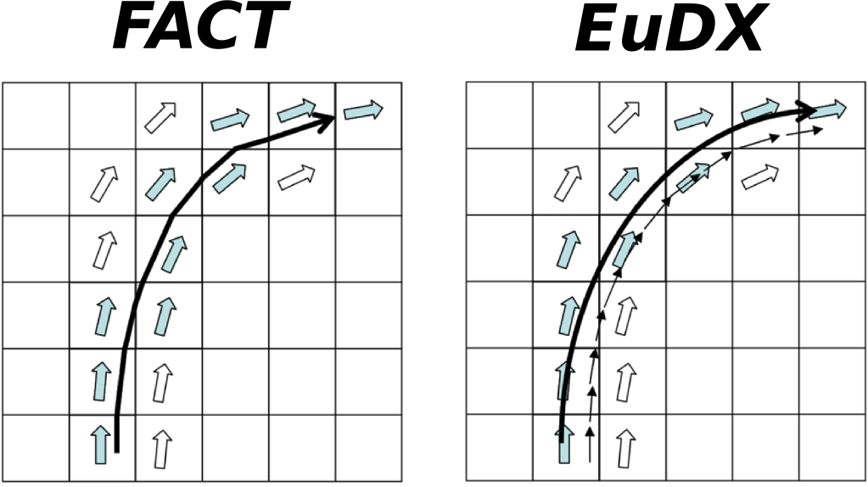

Deterministic tracking
FACT Interpolated
The track follows a path parallel to the principal eigenvector until the border of the voxel.
The step size is not fixed
Works well with low curvature regions
FACT is used in DTI-Studio and TrackVis
At each step a new direction is interpolated taking into account the surrounding eigenvectors
Step size is fixed
Available in Dipy (Garyfallidis, Frontiers 2014)
New Position
Old Position
Step Size
Principal Eigenvector
= + x
E

Slide 7
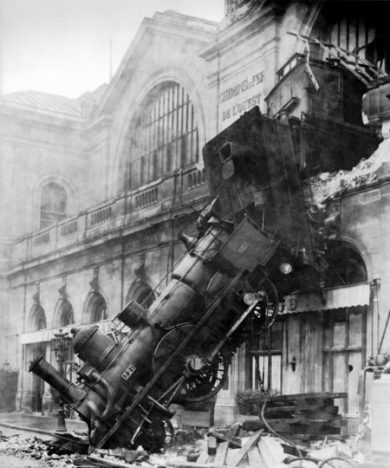
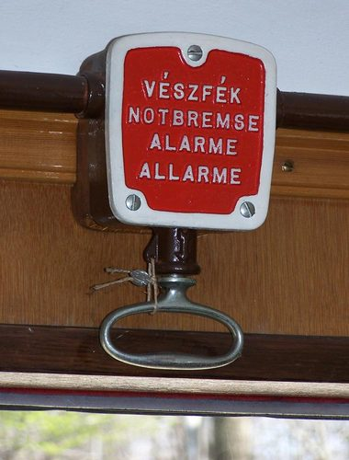
Stopping rules
How to stop streamlines ?
E

Slide 8
Euler Delta Crossings (EuDX)
E

Slide 9
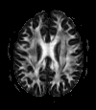
Stopping rules
How to stop streamlines ?
Level of Anisotropy
Start if FA > threshold and Stop if FA < threshold (FA ~0.15/0.20)
To avoid regions with low anisotropy (high noise effect and variability)
To avoid tracking in regions like CSF and GM
Angle of curvature
Fibers should not turn too sharply
Stop if the ANGLE between the old and new direction is > threshold
it depends on the algorithm used ( e.g FACT vs Euler )
It depends on the resolution of your dataset ( angle ~30°/ 45°)
θ
E

Slide 10
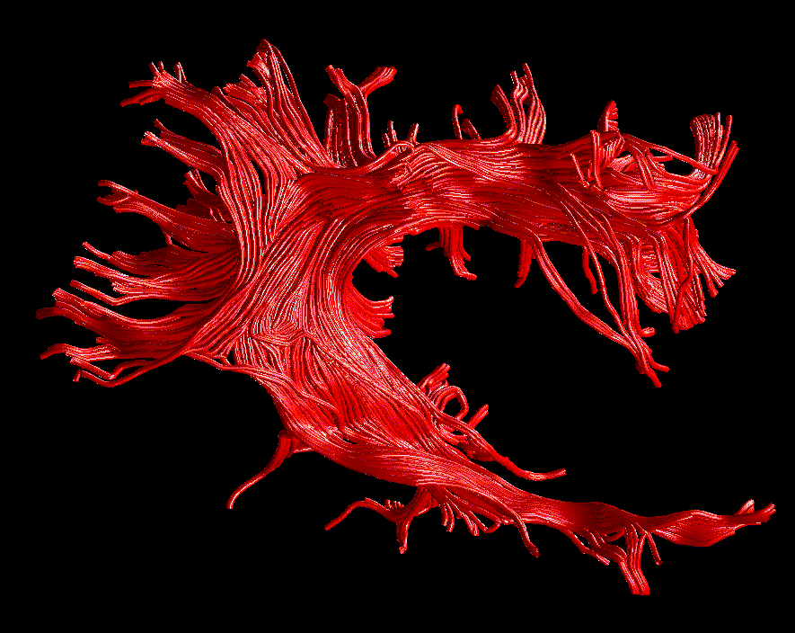
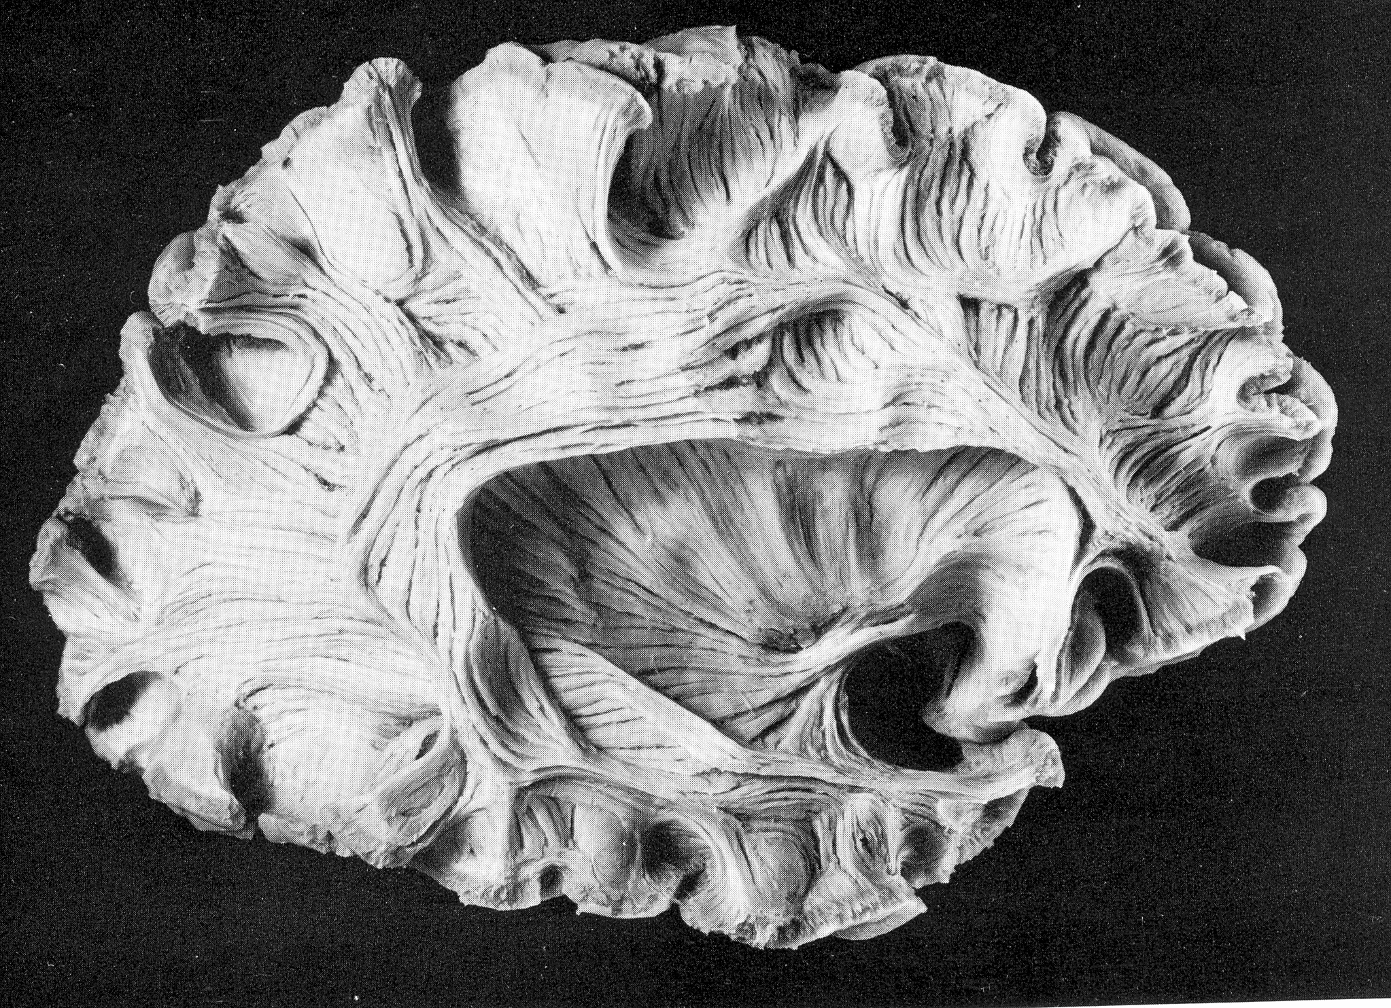
The result
Arcuate Fasciculus
SHORT FIBRES
LONG FIBRES
Virtual In-Vivo Dissection
Post-Mortem Dissection
Lights and Stream-tubes are used to obtain a better 3D visualization.
The size of the tubes is arbitrary and it doesn’t represent the real fascicles!
Catani et al. NeuroImage 2002

Slide 11
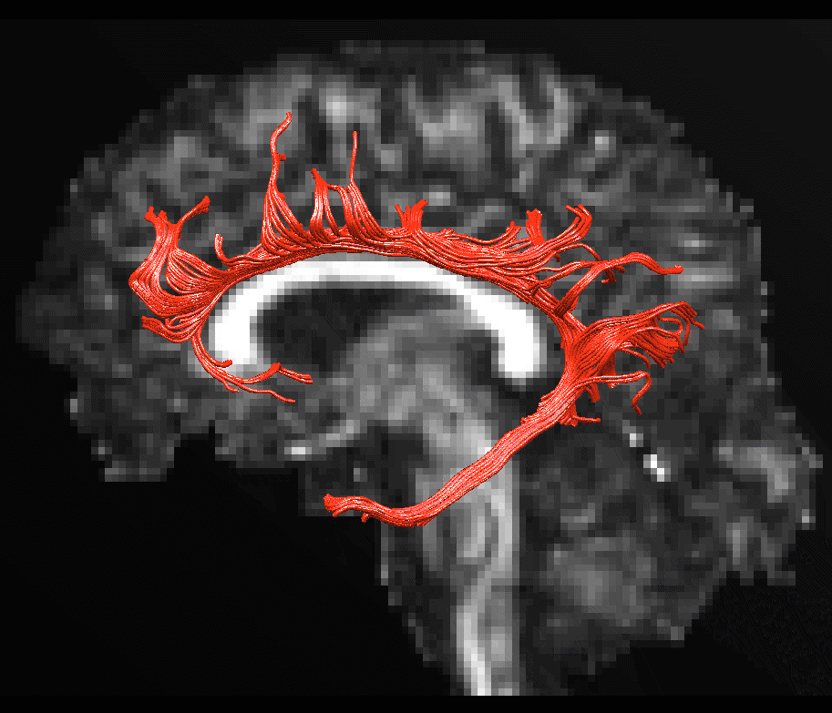
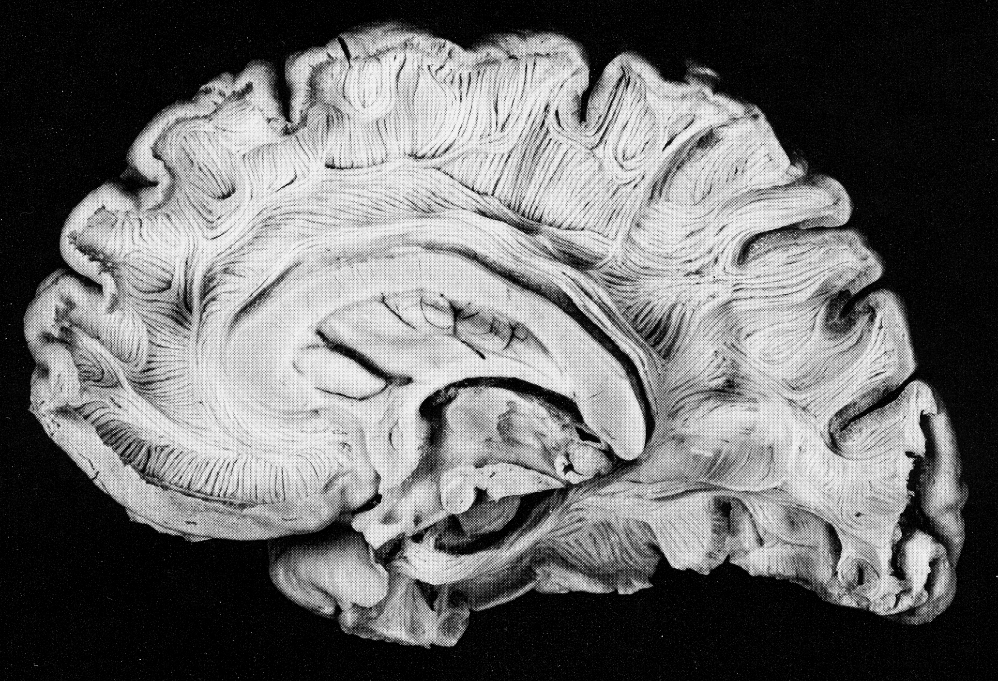
The result
Cingulum
SHORT FIBRES
FRONTAL FIBRES
PARIETAL FIBRES
LONG FIBRES
OCCIPITAL FIBRES
TEMPORAL FIBRES
Virtual In-Vivo Dissection
Post-Mortem Dissection
Lights and Stream-tubes are used to obtain a better 3D visualization.
The size of the tubes is arbitrary and it doesn’t represent the real fascicles!
Catani et al. NeuroImage 2002

Slide 12
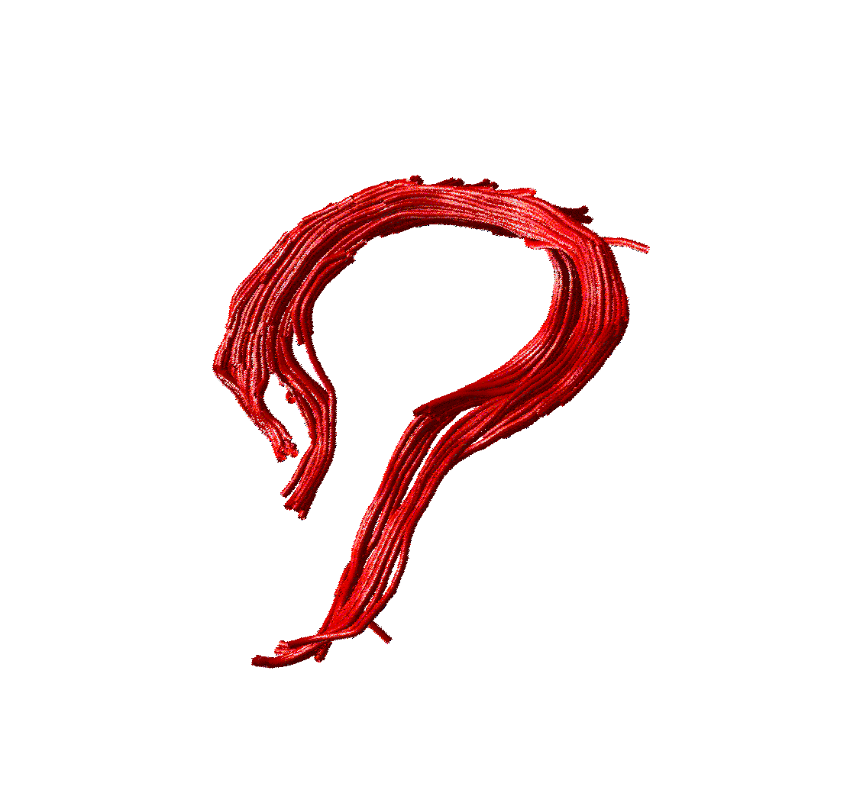
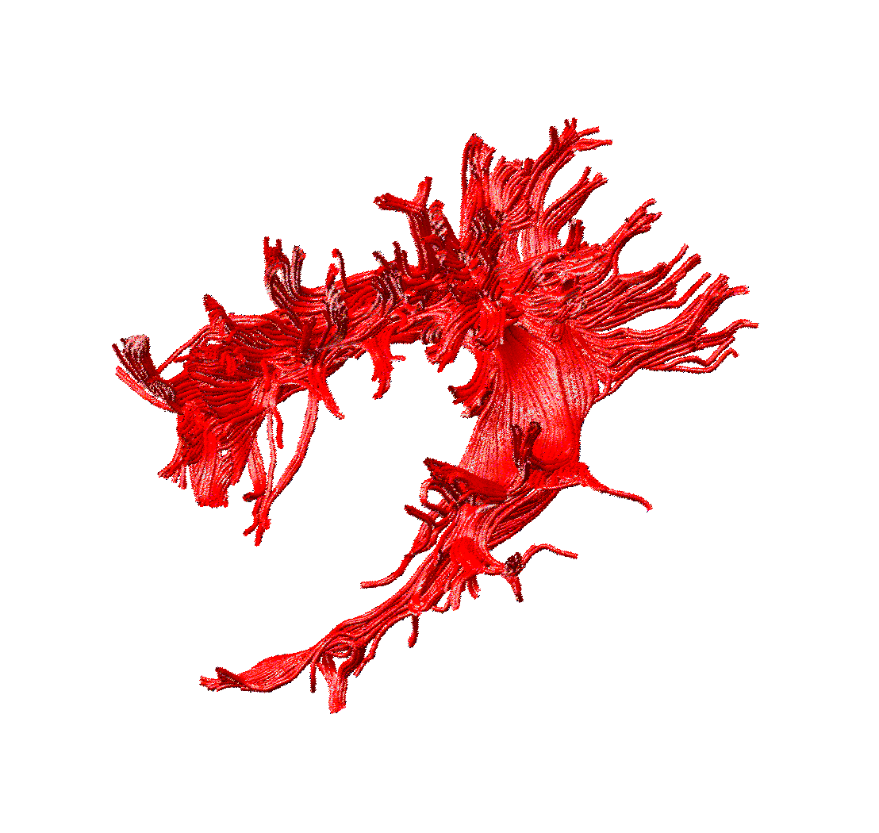
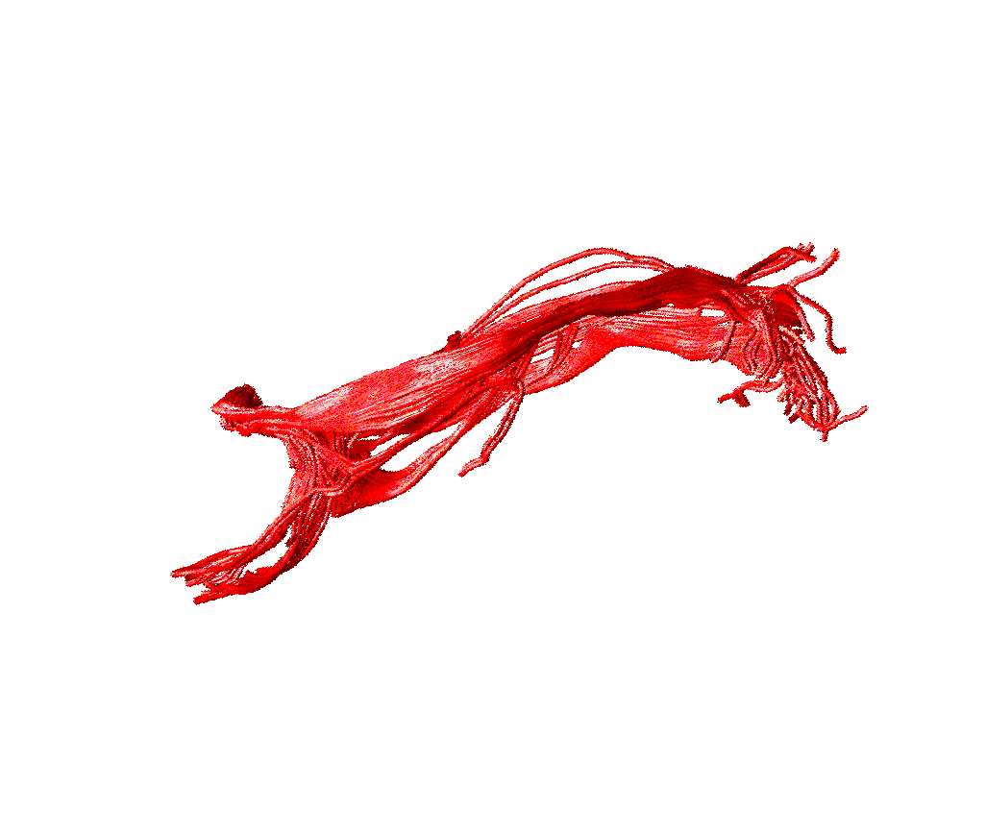
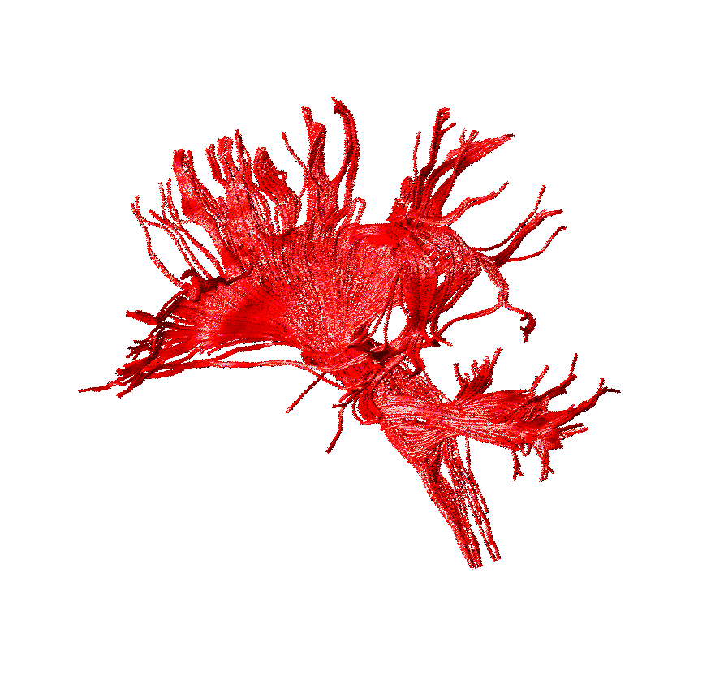
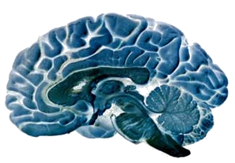
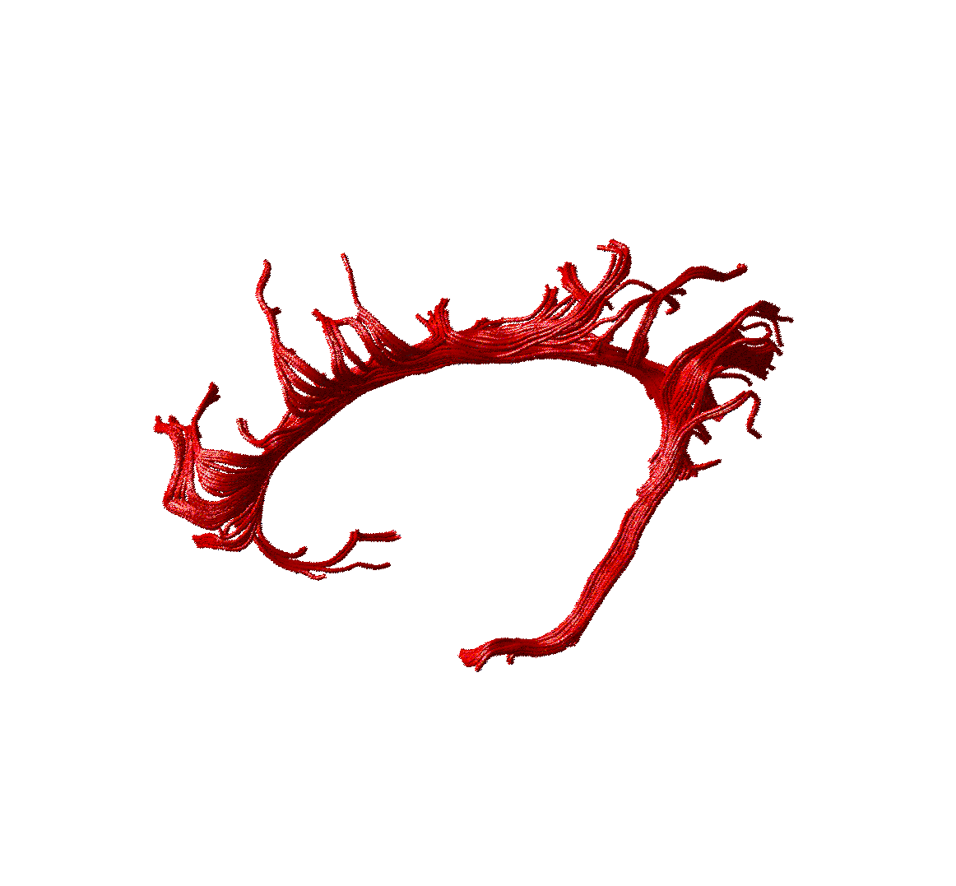
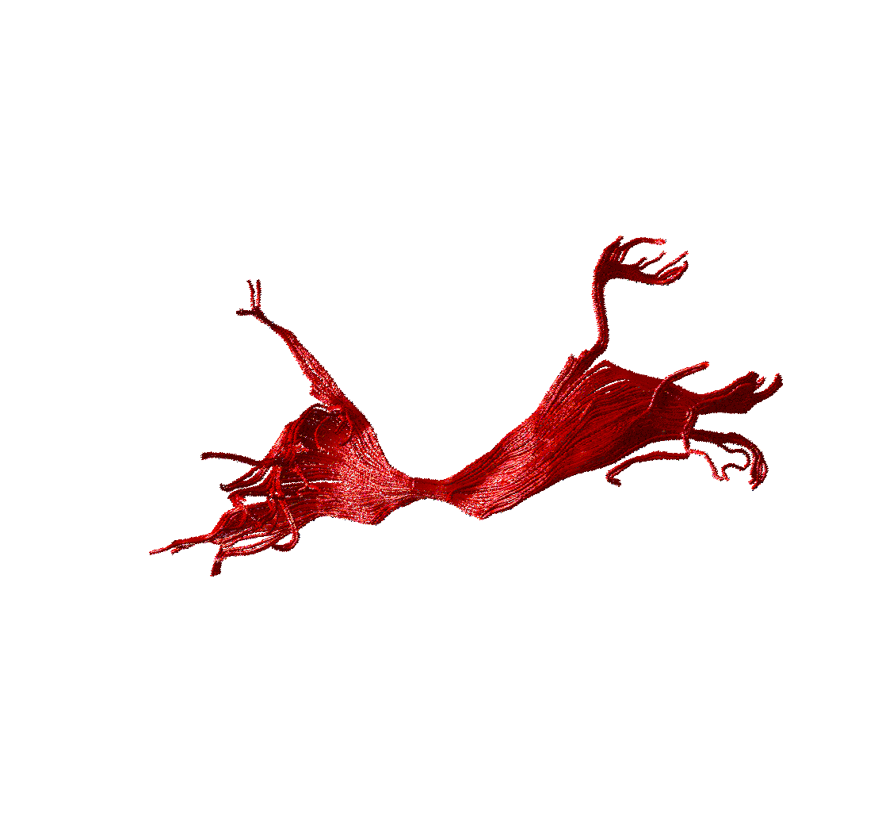
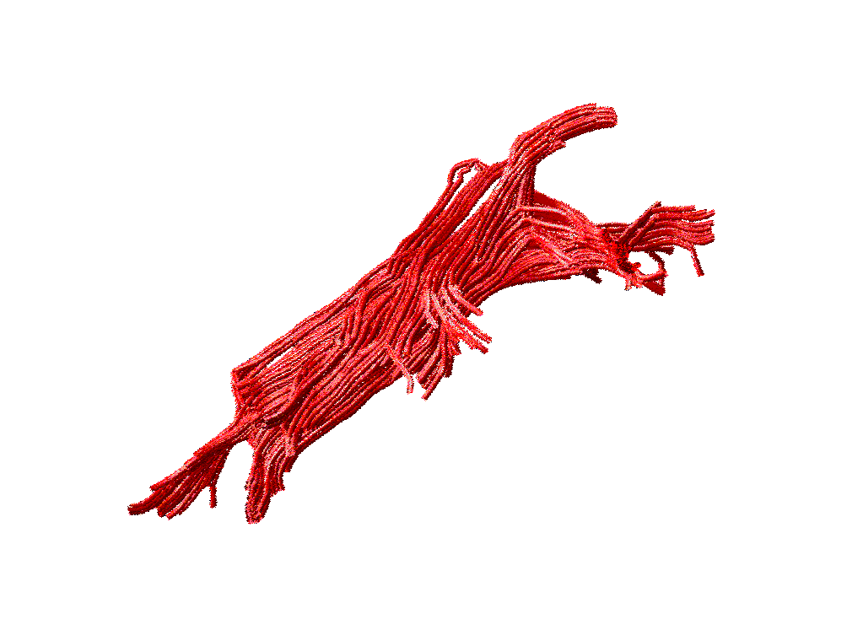
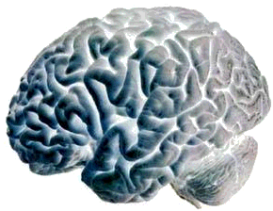
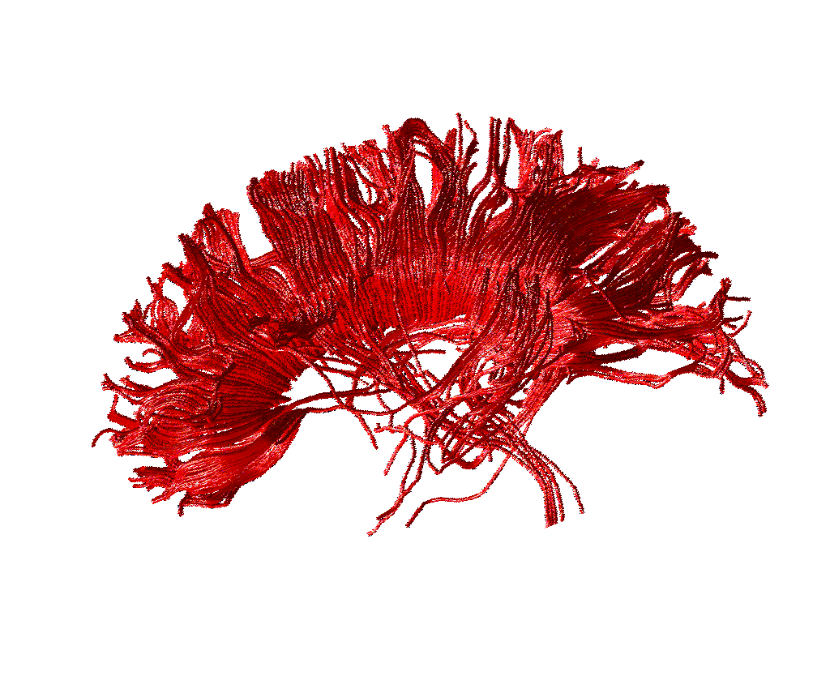
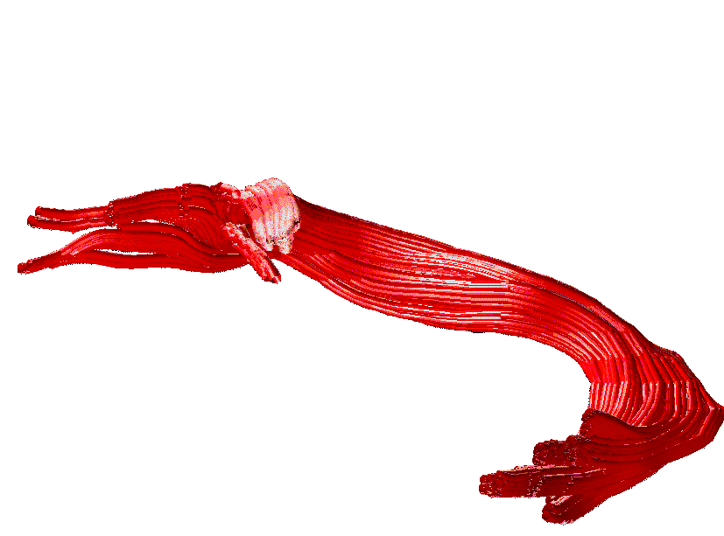
The expectation
ASSOCIATION
PROJECTION
Cingulum
Inferior longitudinal
Corona radiata
Fornix
COMMISSURAL
Arcuate
Uncinate
Inferior fronto-occipital
Corpus callosum
Anterior commissure
Courtesy of Flavio Dell’ Acqua

Slide 13
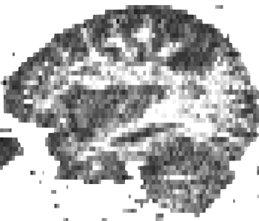
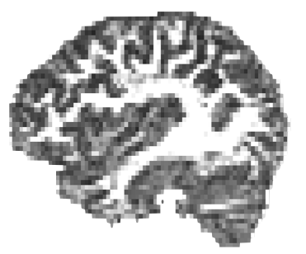
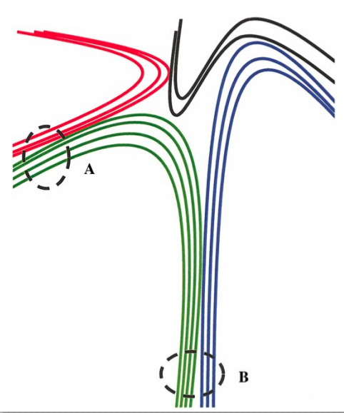
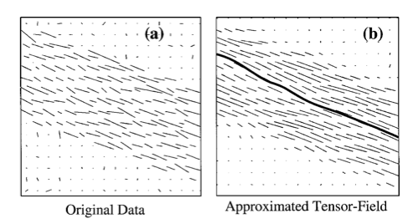
Data quality
low SNR
high SNR

Slide 14
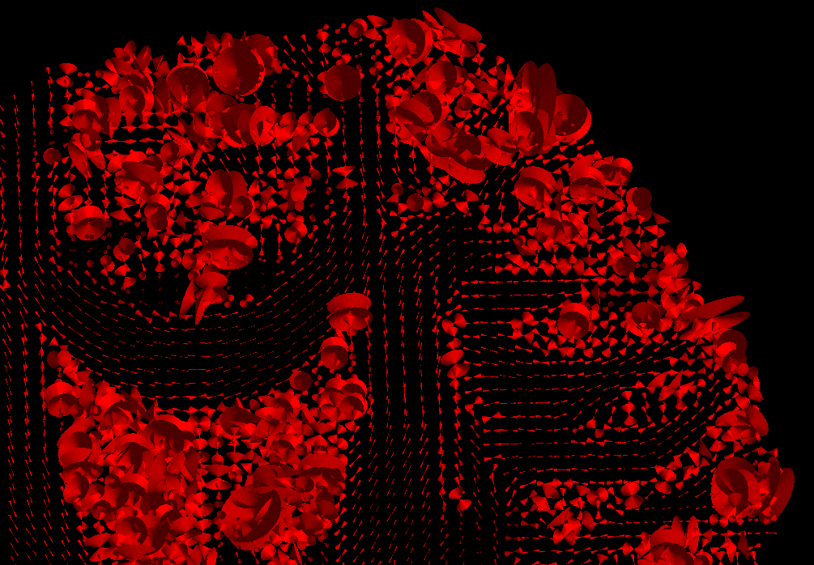
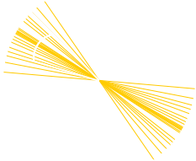
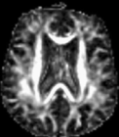
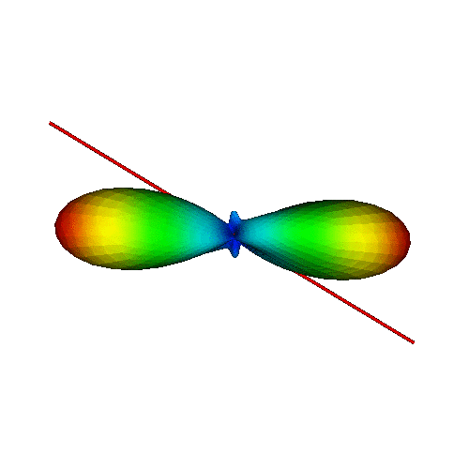
Orientation variability
Measuring variability
95% “cone uncertainty”
Courtesy of Derek Jones
Accounting for variability
Courtesy of Maxime Descoteaux

Slide 15
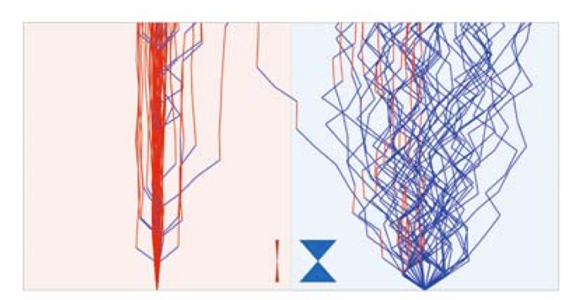
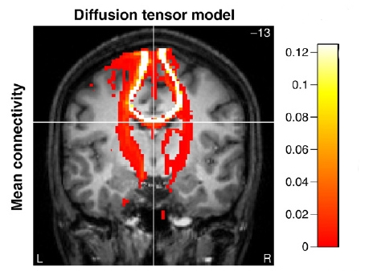
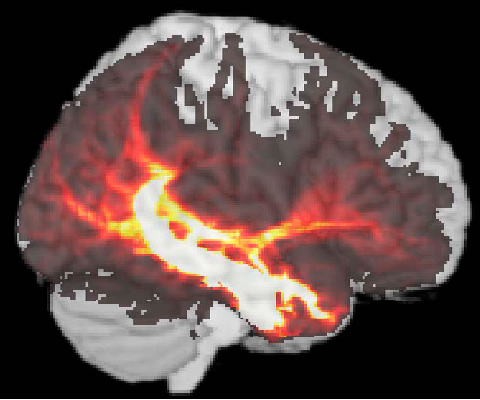
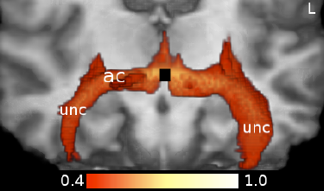
Probabilistic Tracking
Low Uncertainty
High Uncertainty
Kaden E et al.Neuroimage, 2007
Tractography is repeated multiple times from the same seed to map the intrinsic variability or uncertainty in the data
The results are described a probability/connectivity” maps
The intensity represents the number of streamlines per voxel.
PICO : Parker GJ, et al. Magn Reson Imaging, vol. 18: 242-54, 2003.
Descoteaux M et al. TMI, 2009

Slide 16
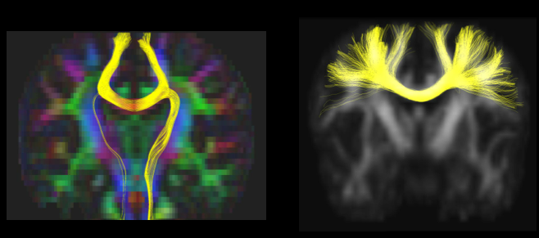
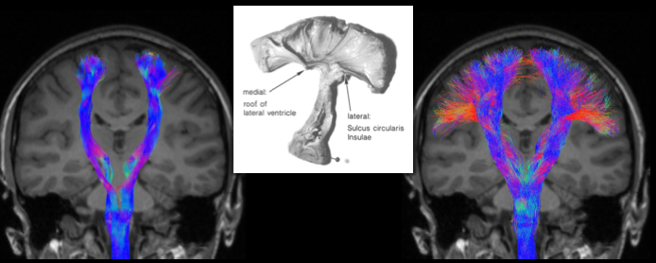
Multiple orientations
DTI
HARDI
DTI
HARDI

Slide 17
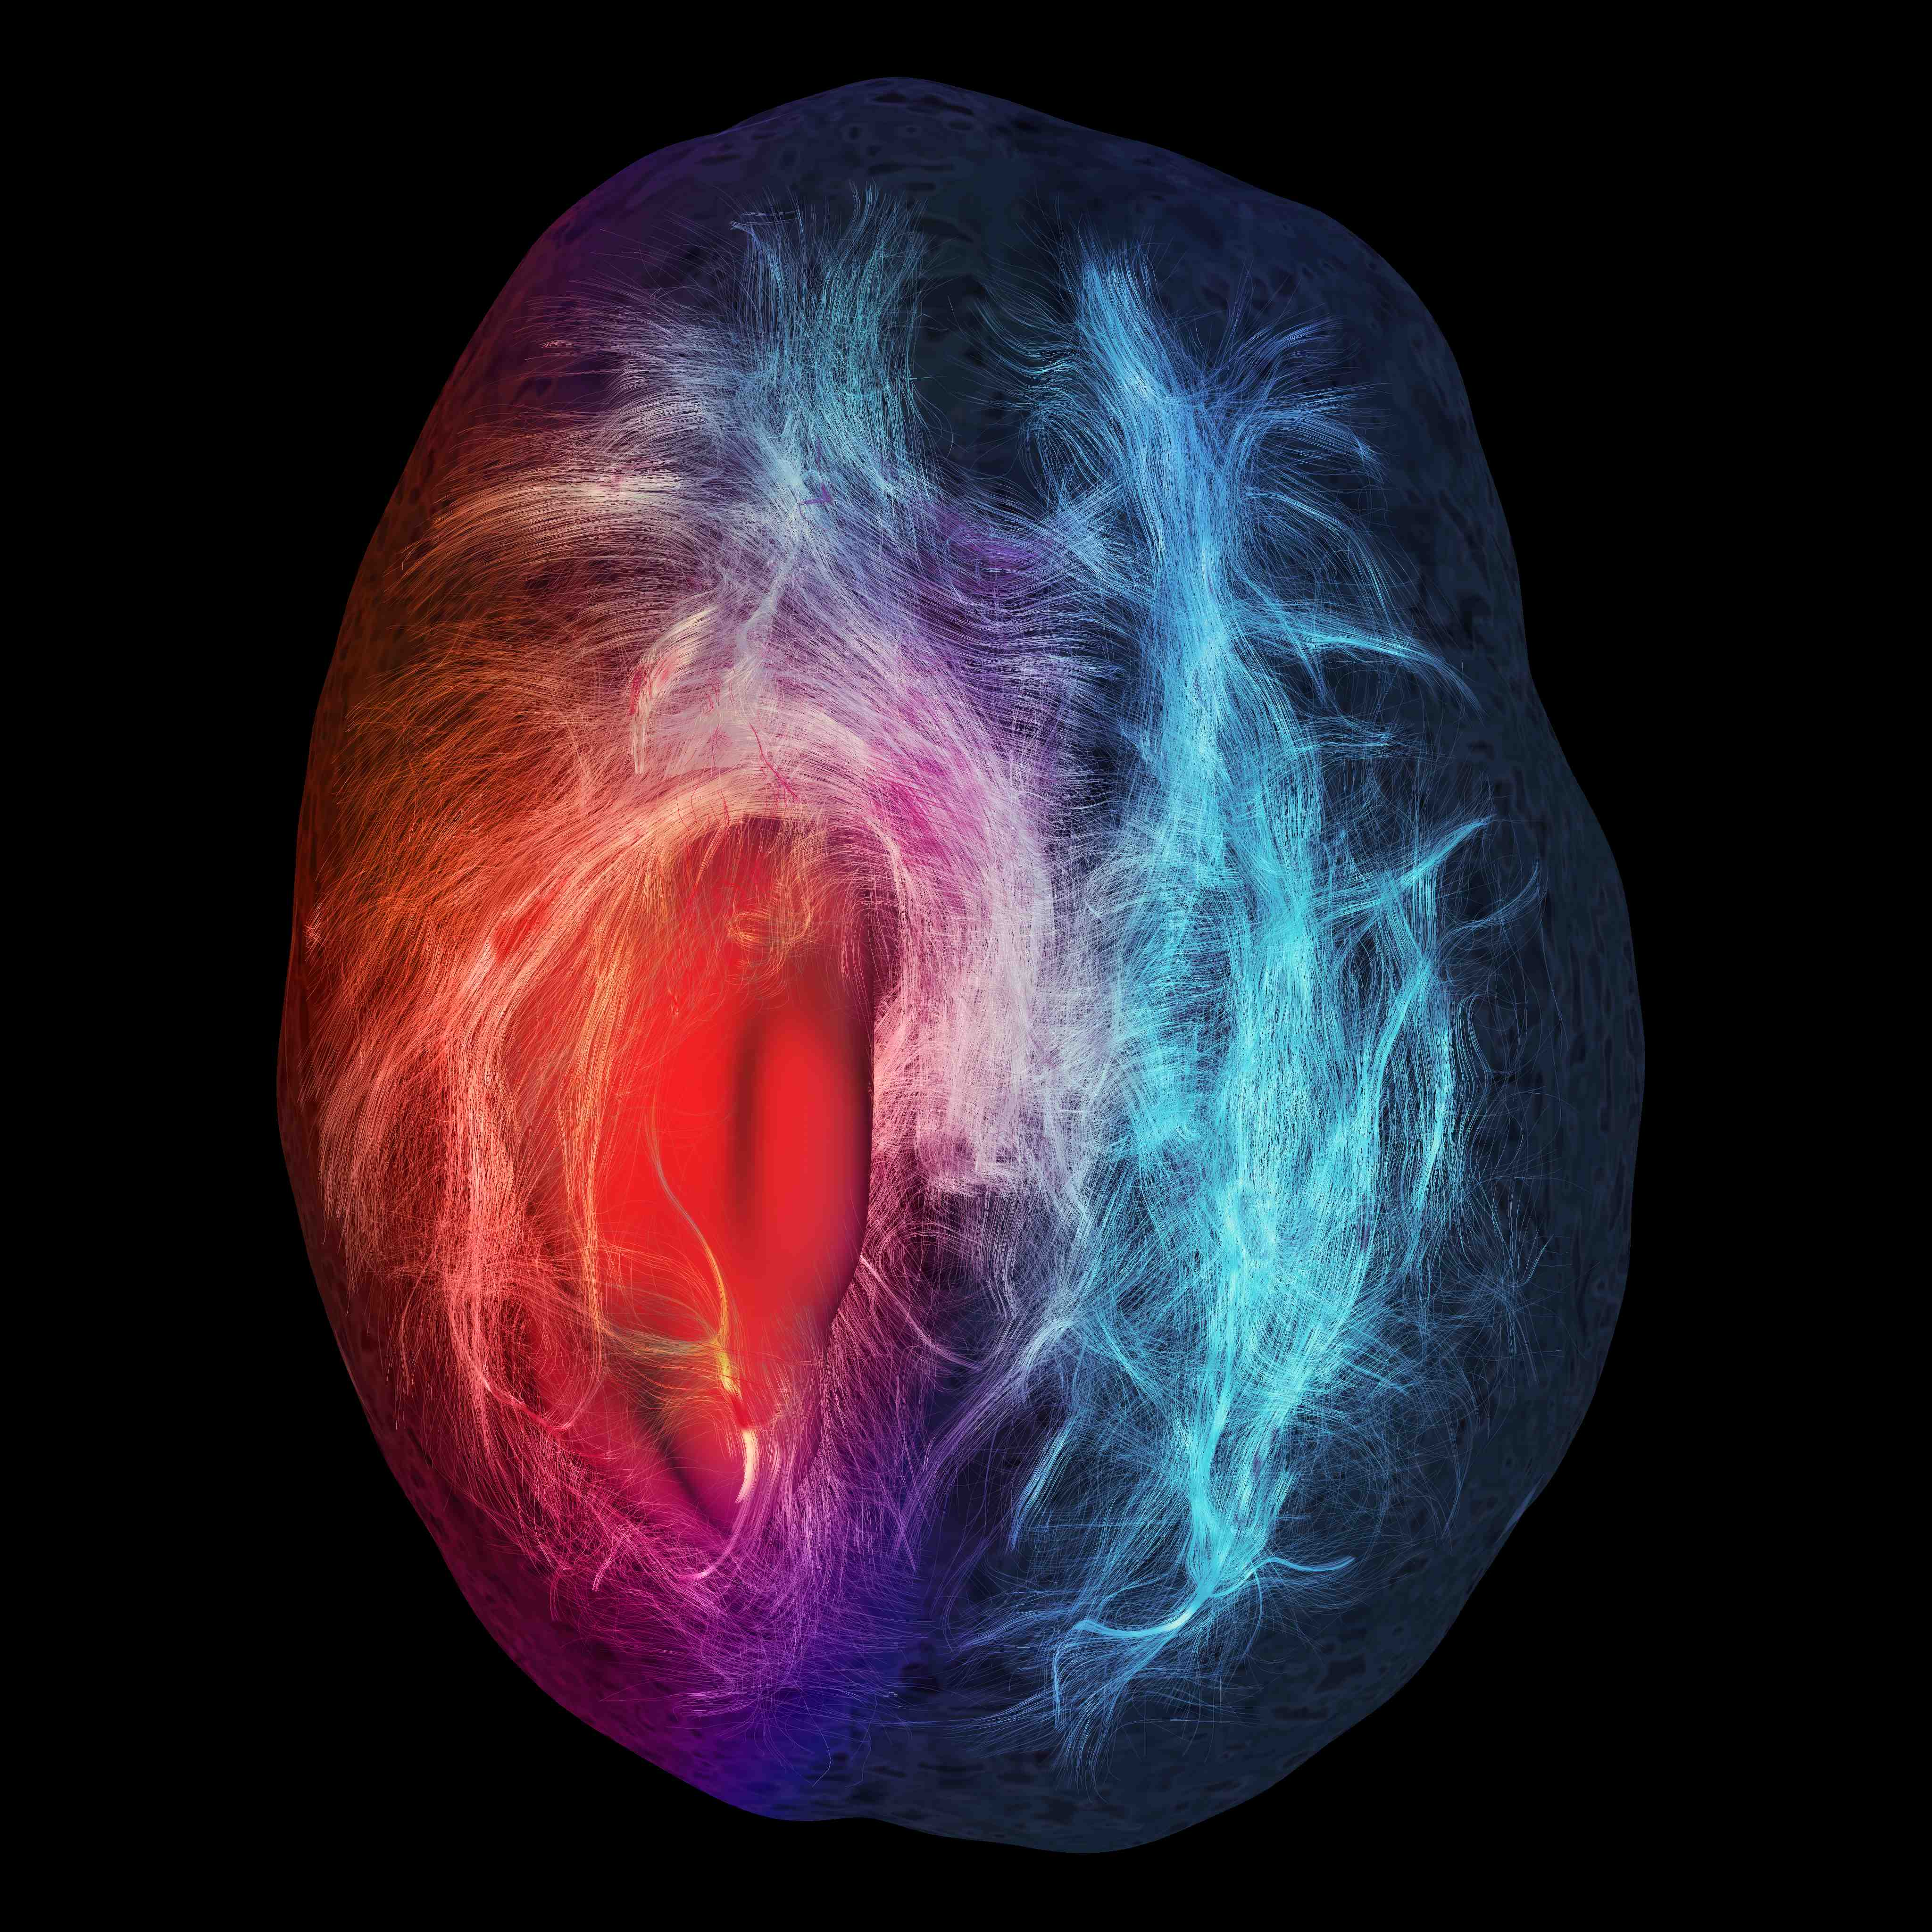
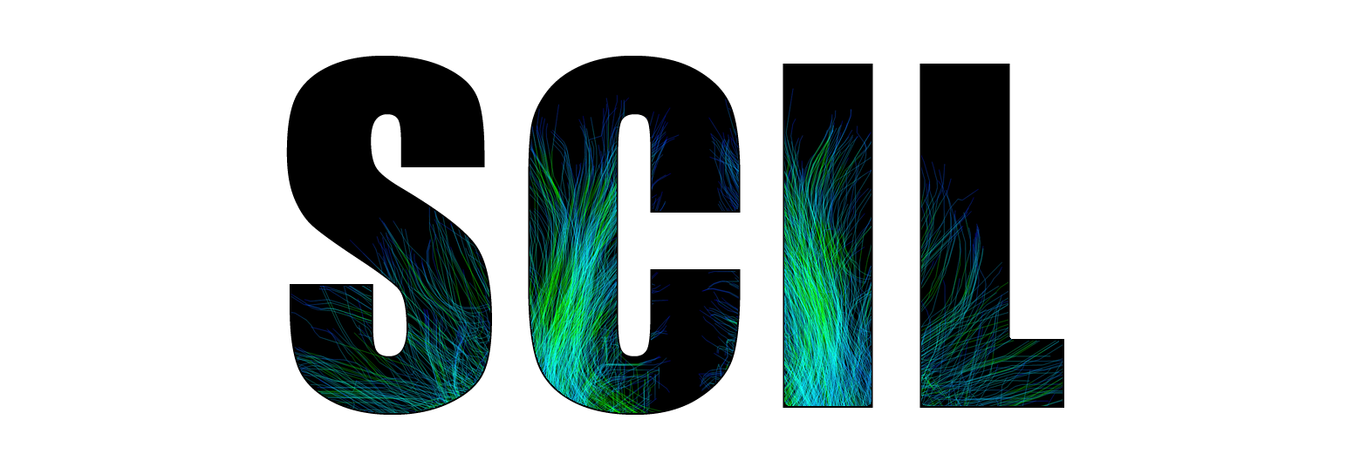
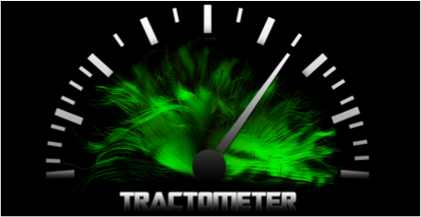

Thank you
http://scil.dinf.usherbrooke.ca
http://tractometer.org

